Slide 1
Barone2
Design Progress Review 2
Dylan Harootunian
Chin Ming Ryan Wong
Leonid Shuster
Jeremy Germenis
George Hernandez
Isaac Szu

Slide 2
Milestones Since Last Design Review
Detailed CAD w/ envelope & electronics 2/20/21: Late
Found Updated Envelope Design: Complete
Added Electronics to CAD: Late
Physics to represent Drone forces 2/25/21: Late
Buoyancy Force: Complete
Throttle: Complete
Thrust and Drag: Late
Design state space controls 2 3/3/21: Incomplete
Remote control design 1/29/21: Late
Needs simulation testing
Interfacing with sensors 2/26/21: Late
Basic interface with sensors: Complete
All sensors working at once: Incomplete
Calibration of sensors: Late
Detailed power budget: Incomplete/Needs Revision
First PCB Design: 1/21/2021 Completed
Wired schematic of sensors for autonomous flight
Notes:
Right, idea,specify how close to complete incomplete milestones are.
Estimated completion time

Slide 3
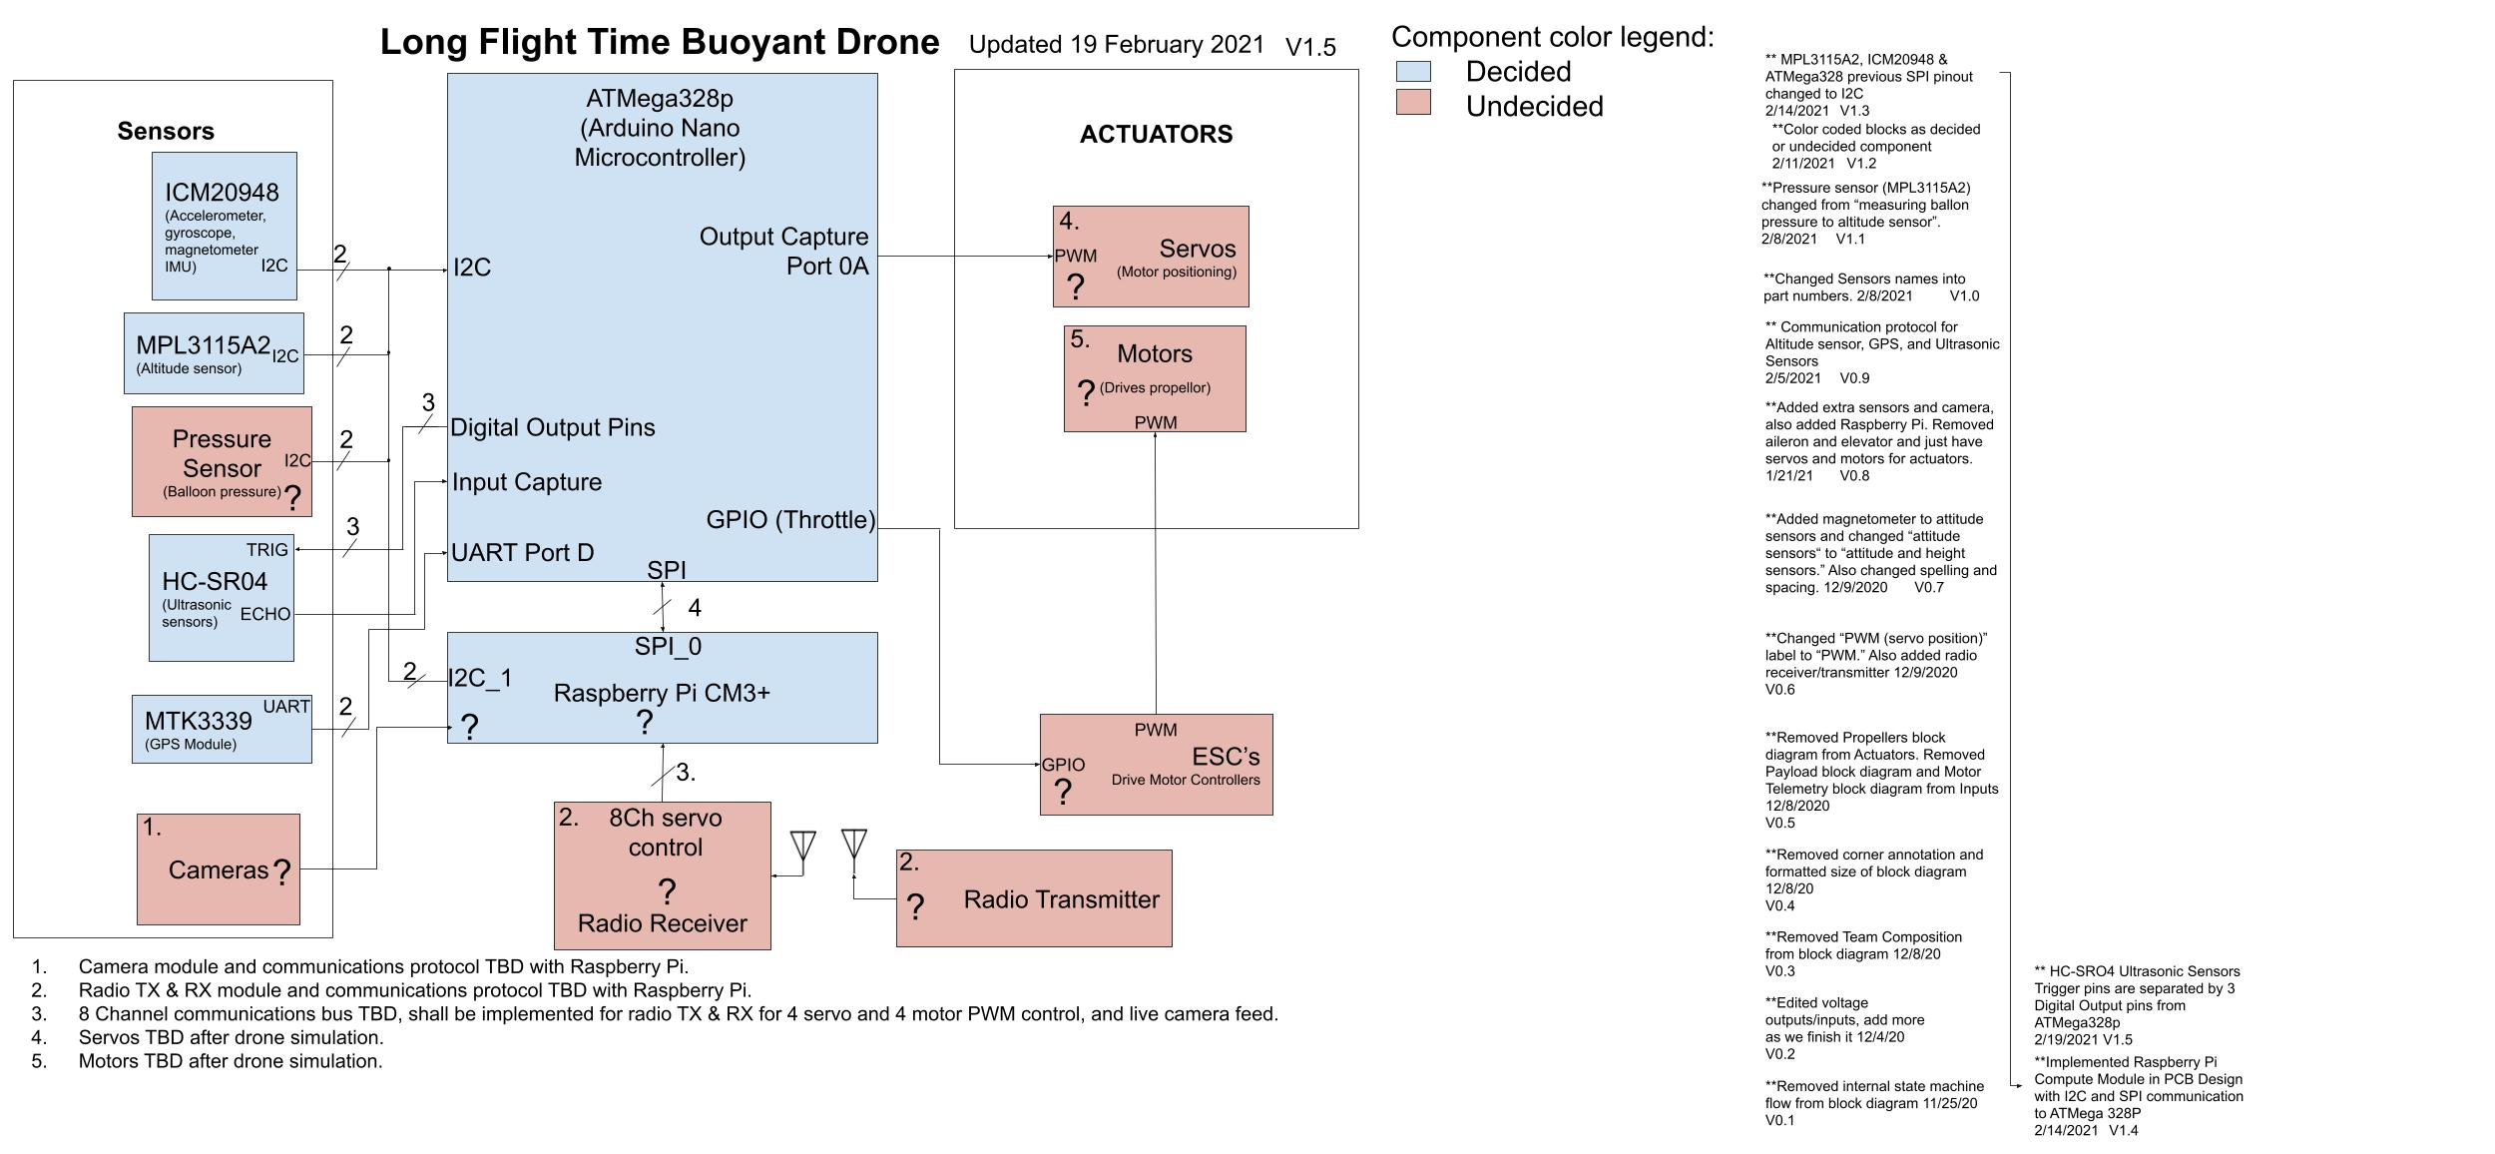
System Block Diagram
Goal:
Show high level layout of parts for a remote/autonomous controlled buoyant drone
Conclusion:
Blue parts are decided, orange parts are not
Notes:
This is a high level layout of our system block diagram. The blue blocks are implemented hardware designs and the red blocks are undecided. The drone has all the sensors needed for autonomous mode but lacks remote control.

Slide 4
Technical Requirements
1.0.0 - Drone Flight Time
Drone shall fly for at least 30 minutes with a 1 hour stretch goal
1.1.0 - Power Usage
Component power should be optimized in part selection, design, and usage
1.1.1 - Hardware
Drone power usage shall consume power within the power budget in one cycle
1.1.2 - Battery
Battery shall be capable of powering all components for at least one cycle
1.2.0 - Minimal Drone Speed
Drone shall be able to fly at least 5mph in winds up to 15mph
2.2.0 - Lift Bag Capacity
The drone shall have a lift bag capable of counteracting drone mass
3.1.2 - Remote Control
Adjust remote control system in order to avoid unwanted moments
4.0.0 - Autonomous Control
Setup Plant for control system in state space form

Slide 5
Technical Requirements
4.1.1 - GPS Sensor
Tracked by MT3339 GPS Module
Programmed GPS to determine longitude/latitude
4.2.1 - Ultrasonic Sensors
Terrain tracking <4m tracked by HC-SR04
Programmed ultrasonic to measure distance
4.2.2 - Barometric Sensor
Altitude tracking >4m tracked by MPL3115A2
Programmed barometric to measure pressure and temperature
4.3.1 - IMU Sensor
Acceleration, gyroscopic movement, and magnetometer measurements tracked by ICM-20948
Programmed IMU for accelerometer, gyroscope, and magnetometer measurements
4.7.0 - Switch from RC to Autonomous mode
Autonomous mode pre-planned path programmed via physical USB Type C port to ATMega328P

Slide 6
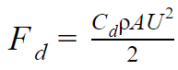
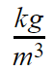
Finding Optimal L/D Ratio for Drag Force on the Envelope
1.2.0
2.2.0
Drag Force
Goal: Find optimal L/D ratio for drag on envelope
Ellipsoid showing L & D
D
F_{d} = Drag Force
C_{d}= Drag Coefficient
⍴= Air density 1.225
A= Frontal/Attack Area
U= Air Speed
L
Conclusion: After Analysing the drag force equations and considering various factors an L/D ratio of 108/40 or 2.7 was decided
The steps of this process will be discussed on the following slides
Equations from Blevins, Robert D. Applied Fluid Dynamics Handbook. Repr. ed. with corrections. Malabar, Fla.: Krieger Pub. Co., 1992.
Notes:
Get rid of background
Add caption saying its envelope
Conclusion

Slide 7
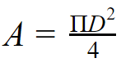
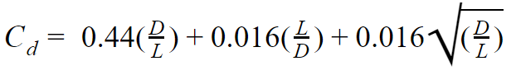
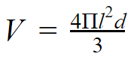
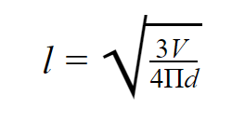
Finding equations for values in Drag Force Equation
1.2.0
2.2.0
Goal: Find equations for all variables in drag equation
Attack area of ellipsoid
d
l
Ellipsoid showing l and d
Drag Coefficient for 1<L/D<10
Lowercase l and d are radii
Uppercase L and D are diameter
Volume equation of Ellipsoid
Volume equation rewritten to determine l from given V and d, so different ratios can be tested with a constant V
Conclusion: Equations can be plugged into Matlab to find drag force at various ratios and volumes.
Equations from Blevins, Robert D. Applied Fluid Dynamics Handbook. Repr. ed. with corrections. Malabar, Fla.: Krieger Pub. Co., 1992.
Notes:
Make d subscript
Make equations look better

Slide 8
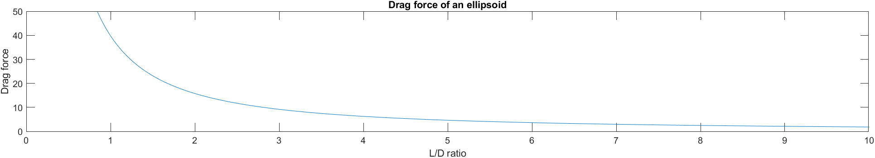
Drag Analysis Simulation
1.2.0
2.2.0
Goal: Use MatLab to find best ratio
All measurements taken at standard air density since the barone will be flying close to the ground
Airspeed is set to 20 MPH to reflect 5 MPH speed + 15 MPH wind to assume worst case for our criteria (1.2.0)
Volume set to 4 cubic meters for initial analysis to reflect lift bag requirement (2.2.0)
(N)
Sphere
Old Design
Final Decided ratio (2.7)
Conclusion: The Drag Force on the envelope will exponentially decrease in the horizontal direction as L/D increases.
It can be inferred that in the vertical direction the Drag Force increases inversely

Slide 9
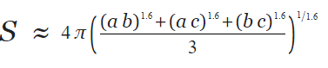
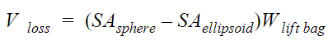
Finding Volume lost from spherical Lift Bag Inside Ellipsoidal Envelope
Goal: Find Volume loss from excess lift bag
1.2.0
2.2.0
Since the lift bag is a sphere and the envelope is an ellipsoid there will be volume loss inside the ellipsoid from the wrinkles in the lift bag
First surface area of a sphere and ellipsoid of the lift bag inflation diameter was calculated:
Then the difference between the sphere and ellipsoid surface are was found and multiplied by the lift bag thickness to find volume loss:
Note: The thickness used was 1/8th inch which is thicker than the lift bag is in reality, but the overestimation leaves room for error.
Conclusion: the 8’ bag loses 0.0175m³, the 9’ bag loses 0.0282m³
Equations from Blevins, Robert D. Applied Fluid Dynamics Handbook. Repr. ed. with corrections. Malabar, Fla.: Krieger Pub. Co., 1992.

Slide 10
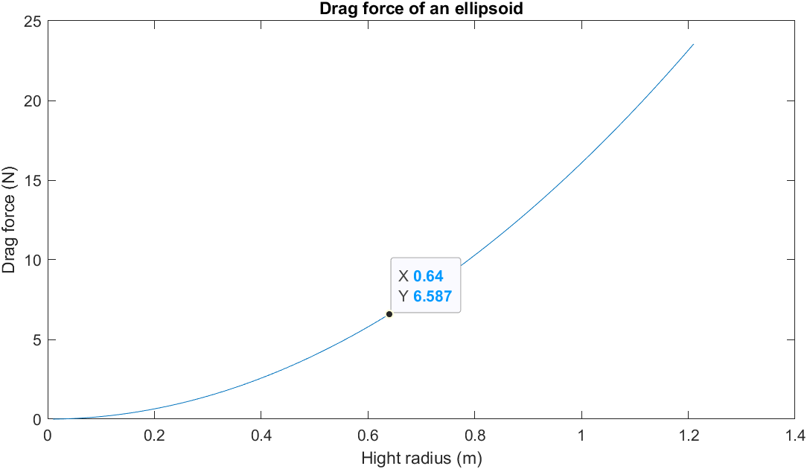
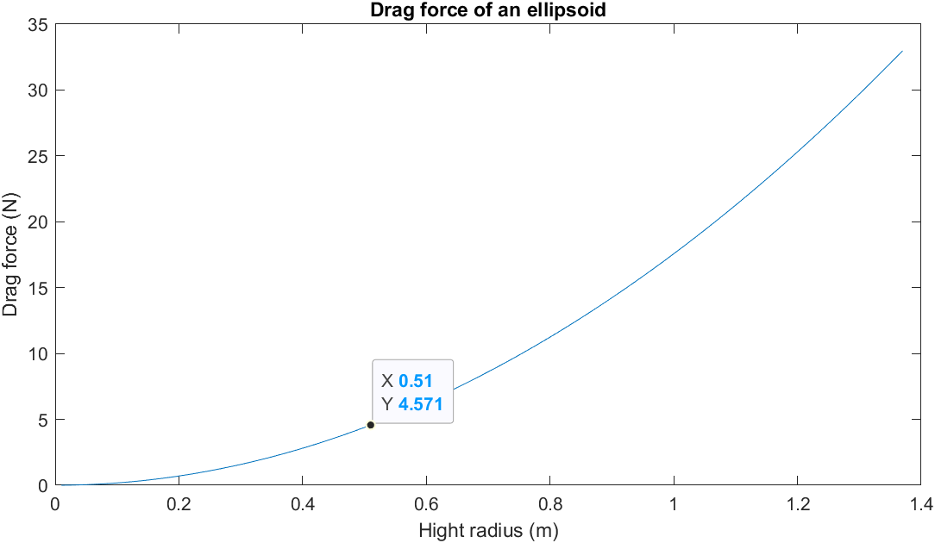
Drag Analysis Simulation With Adjusted Volumes
Goal: Use MatLab to see if the mass increase from the large balloon worth it?
1.2.0
2.2.0
The points on these graphs represent the best ratio of the envelope achievable with two lift bag sizes The volumes have been scaled to match the weight of the lift bag and the volume loss from excess lift bag.
The increase in envelope mass for the larger size has NOT been accounted for.
25N
31.7N
8’ diameter balloon 300g
9’ diameter balloon 350g
Conclusion: The increased mass and loss of volume from the larger balloons still results in a net drag decrease.
Notes:
Top point on curve is the drag in the vertical direction

Slide 11
Drag Analysis Conclusion
1.2.0
2.2.0
Goal: Come to a conclusion of best lift bag from analysis
The larger the L/D ratio is the less drag in the horizontal direction the envelope will experience. (Long and short is better)
The same ratio will increase vertical drag as horizontal drag decreases however this is not a huge concern
The drone will not be doing much vertical movement as its hight stays constant
Low to the ground where the drone flies there is less vertical wind
Sato, Kaoru. " Vertical Wind Disturbances in the Troposphere and Lower Stratosphere Observed by the MU Radar". Journal of Atmospheric Sciences 47.23 (1990)
Sizes above the 8’ and 9’ balloon looked at in this analysis will become harder to fabricate an envelope for and where not looked at in this analysis.
Conclusion: the 9’ diameter balloon sitting in a 104”x40.27” envelope will be used in order to reduce drag compared to the spherical design.

Slide 12
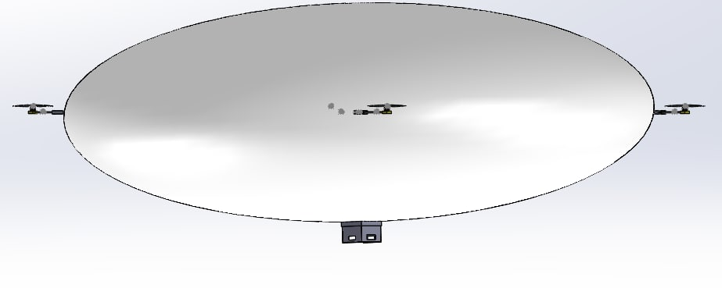
Updated CAD to Match New Envelope Design
Goal: Update CAD to match new envelope design
1.2.0
2.2.0
CAD was updated to be 108”x 40.27”
Gondola and Servo brackets where updated to fit the new envelopes
20.133”
54”
54”
Conclusion: New CAD model good to be imported to simulation

Slide 13
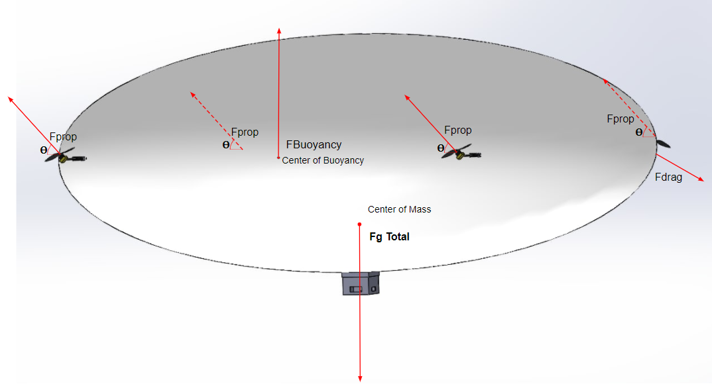
Translational Force Definitions for Controls
4.0.0
Goal: Use a force diagram to show force definitions for use in controls
Prop forces, drag, buoyancy, and gravity are main forces.
Conclusion: Forces defined well enough for starting state space model
Fig. Force diagram for drone. V1
Only showing forces, not moments.

Slide 14
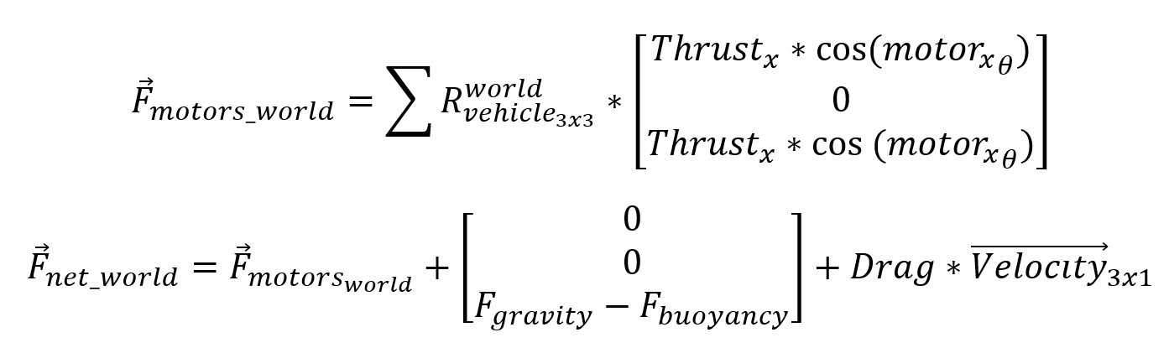
Derivation of Translational Force Equations
4.0.0
Goal: Set up force equations in order to set up controls
NED is north east down coordinate system
Conclusion: Redefined force equations are ready to be put into differential forms, however, there are dependencies on Pitch, Yaw, and Roll

Slide 15
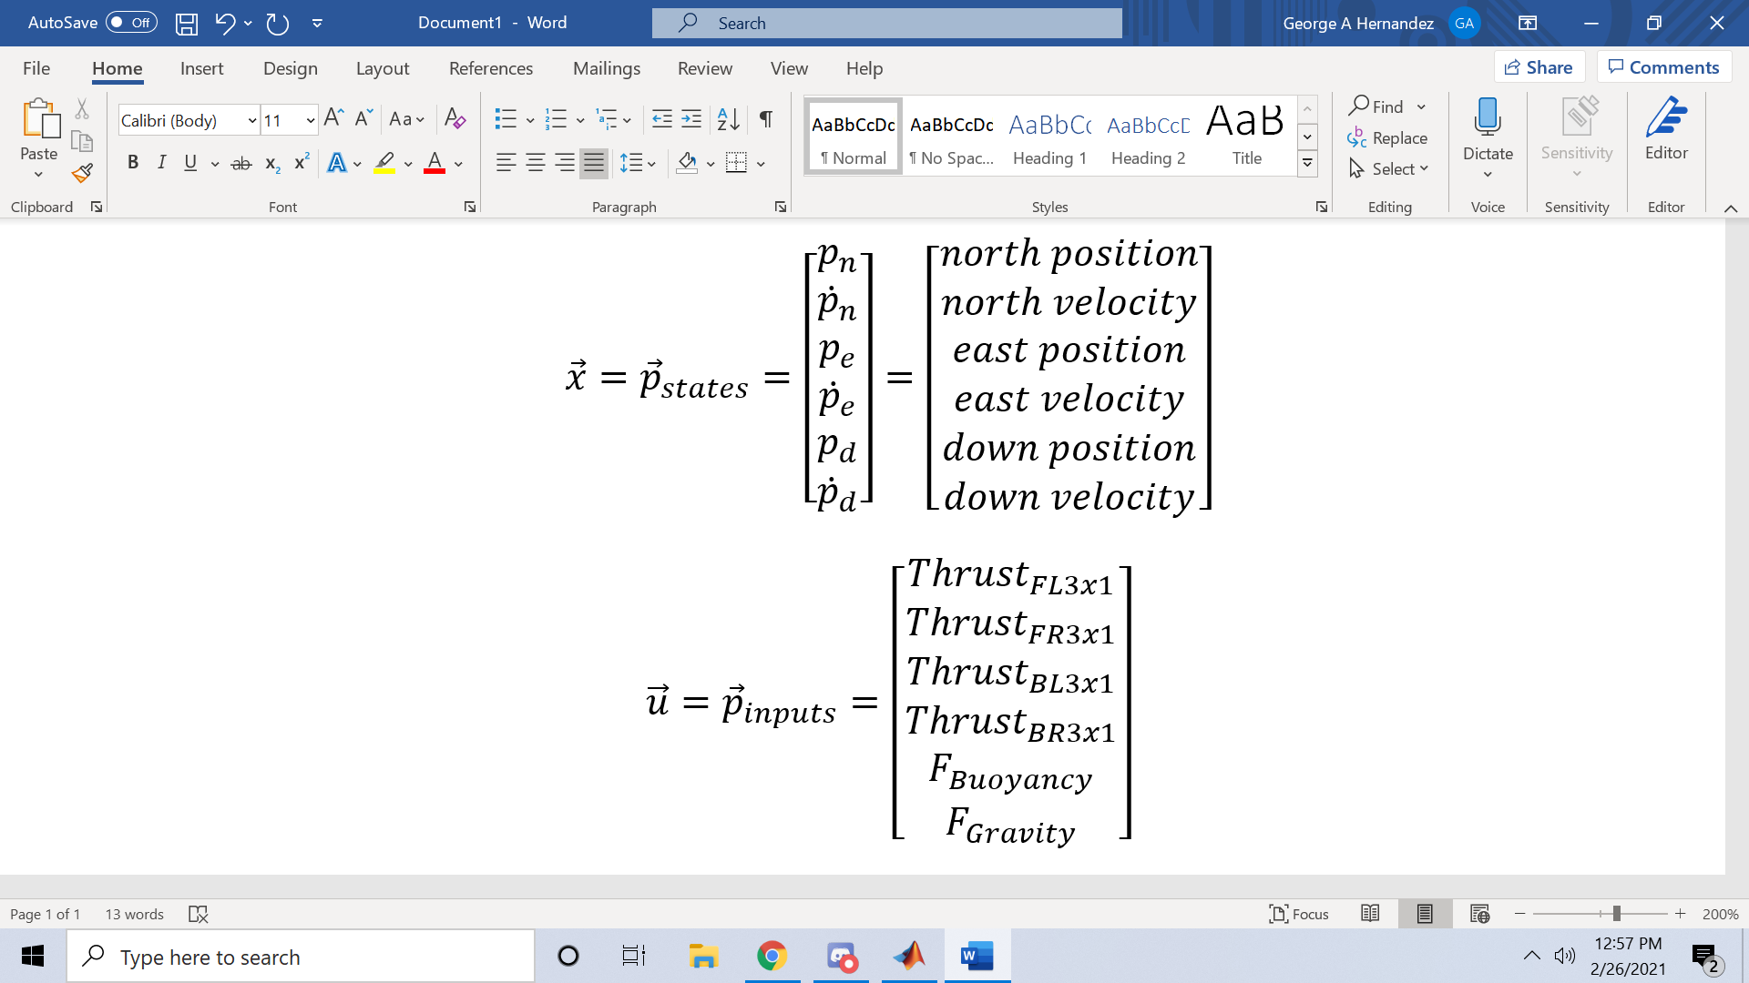
State Space Form Outputs (NED)
4.0.0
Goal: Define outputs for use in state space form
Conclusion: Currently, states vector is equal to the output vector, and may have more outputs than needed, since we are controlling positions, but they can be removed later and might be helpful for simulation.

Slide 16
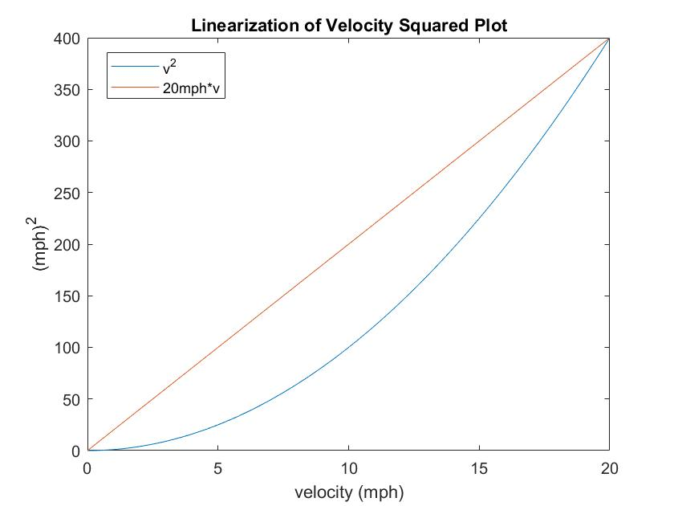
State Space Form Linearization of Drag
4.0.0
Goal: Define drag for state space form
Need to linearize drag equation
Most important points are at zero speed and max speed, 20mph
Multiply velocity by a factor of 20mph in order to linearize velocity squared
Conclusion: Linearization is sufficient for now. In this model it assumes no wind, so we will need to add a wind model to the inputs in the future.
Fig. Linearized plot for drag force. V1

Slide 17
State Space Form Inputs (NED)
4.0.0
Goal: Define inputs for use in state space form
FL refers front left motor, FR front right, BL back left, and BR back right
Conclusion: All inputs here affect the position of the system. Thrust for each of the motors is a function of Throttle, Motor Angle, Pitch, Yaw, and Roll. Sufficient to start State Space Design.

Slide 18
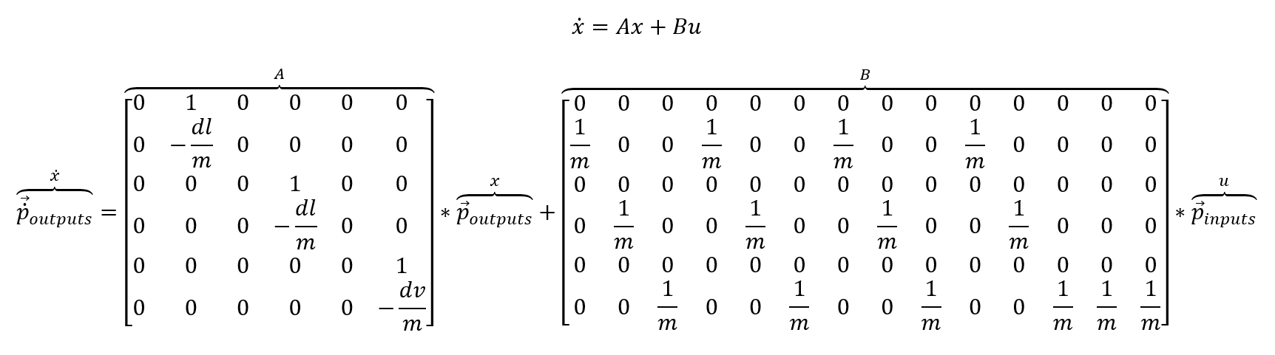
Plant Definition for Controls (NED)
4.0.0
Goal: Define state space form for NED
dl is drag in the lateral direction and dv is drag in the vertical direction
Conclusion: Defines NED plant well, with the exception of the exclusion of wind. Once wind is incorporated, can work to define controls.

Slide 19
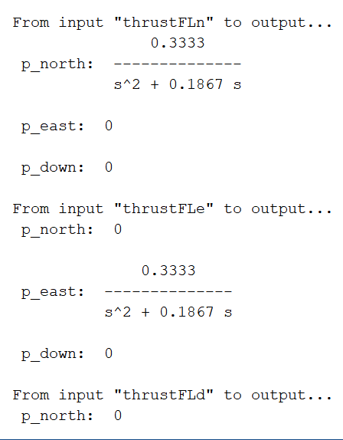
Autonomous Controls Next Steps
4.0.0
Goal: Define next steps for controls design
Model has allowed us to derive transfer functions, so we can begin control design.
We need to add Pitch, Yaw, and Roll outputs
Discretize functions using Zero Order Hold
Incorporate dependencies
Prioritize certain states such as height to avoid crashing
Conclusion: The setup is a good place to start, but the interdependencies of states will make this a challenging problem.
Fig. Some transfer functions derived from state space model in MATLAB

Slide 20
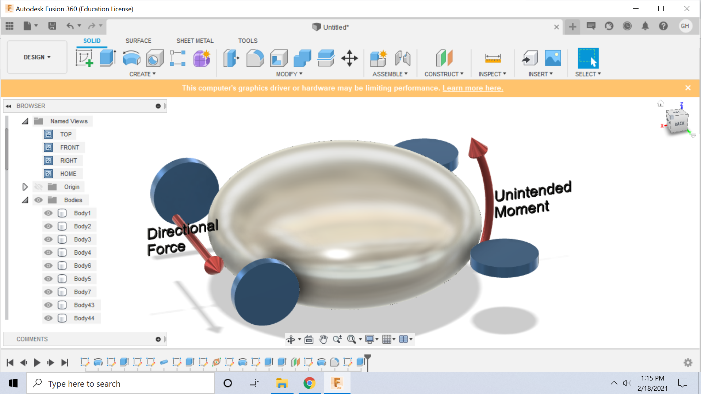
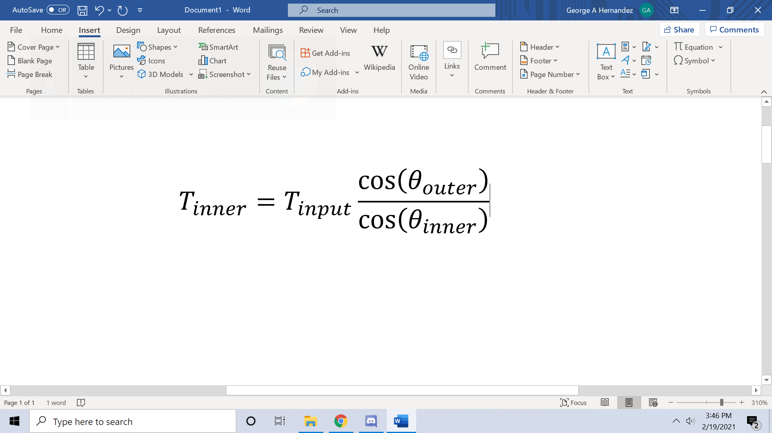
Remote Control Throttle Adjustment
Goal: Original RC method did not account for unintended moments caused by excessive thrust on a singular side during turns
Needed to isolate vertical component on far turn side, and use that as max for near turn side
Conclusion: Change is being implemented, and simulation will determine if it is a sufficient fix, not enough testing yet.
Fig. Unintended moment caused by previous RC iteration. V1
This situation is caused by going forward and turning at the same time, causing the motor angle to point downwards at commanded throttle

Slide 21
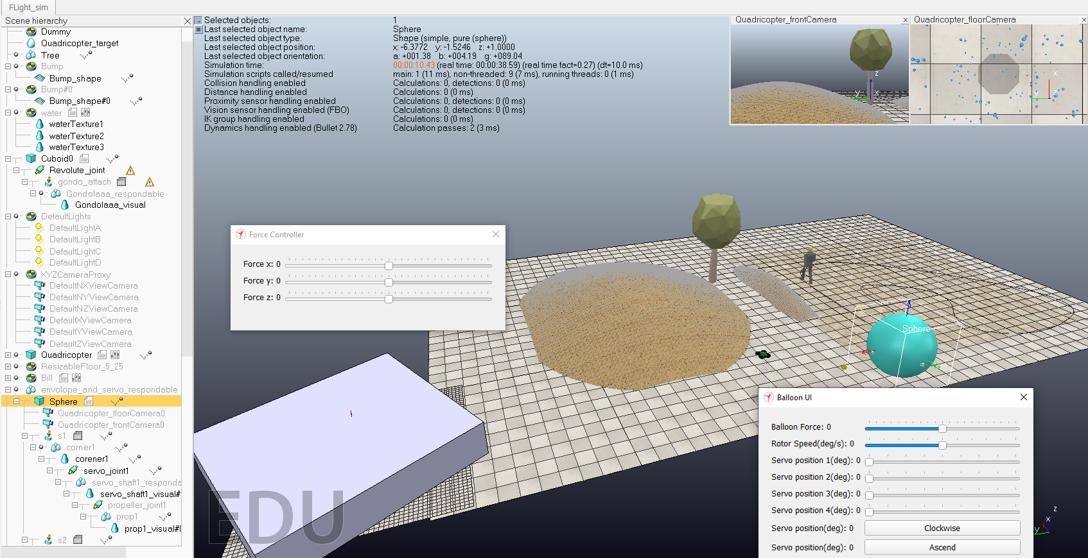
Implementing Balloon GUI
Goal: Balloon User Interface in the process of being implemented would be able to apply buoyant forces, rotor speeds, and servo positions to change the velocity of the balloon.
The purple box on the left is currently being used as a test bench in order to see forces in work and the direction of each of those forces.
Our actual balloon model
TESTBENCH
Conclusion: Forces are still being implemented on the balloon, but can be seen to work on the testbench.
Notes:
Rotor speed control in pairs

Slide 22
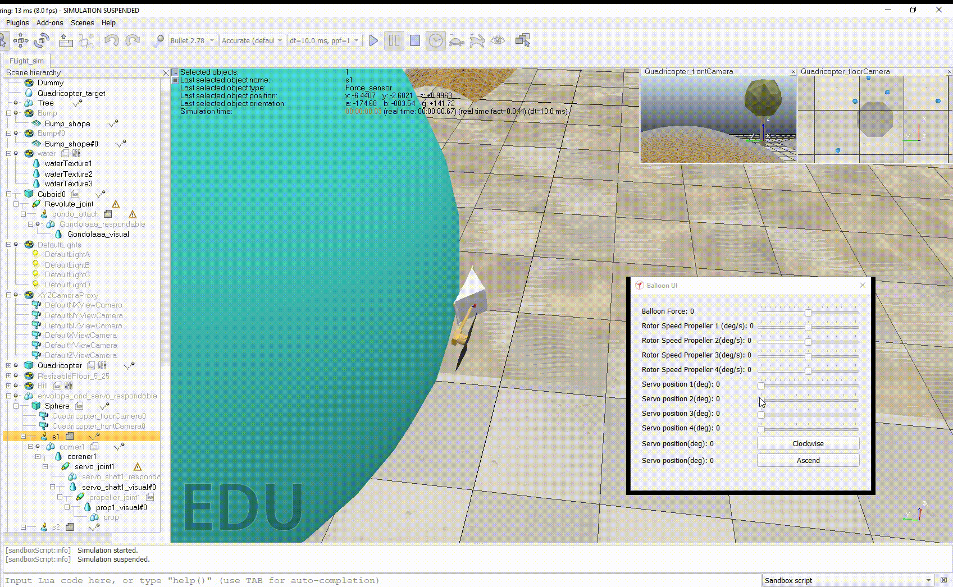
Implement Servo Movement Using GUI
Conclusion: Servo movement allows for changing the direction of the forces of propellers. Using a revolute joint, this movement is applied to all four servos surrounding the balloon.

Slide 23
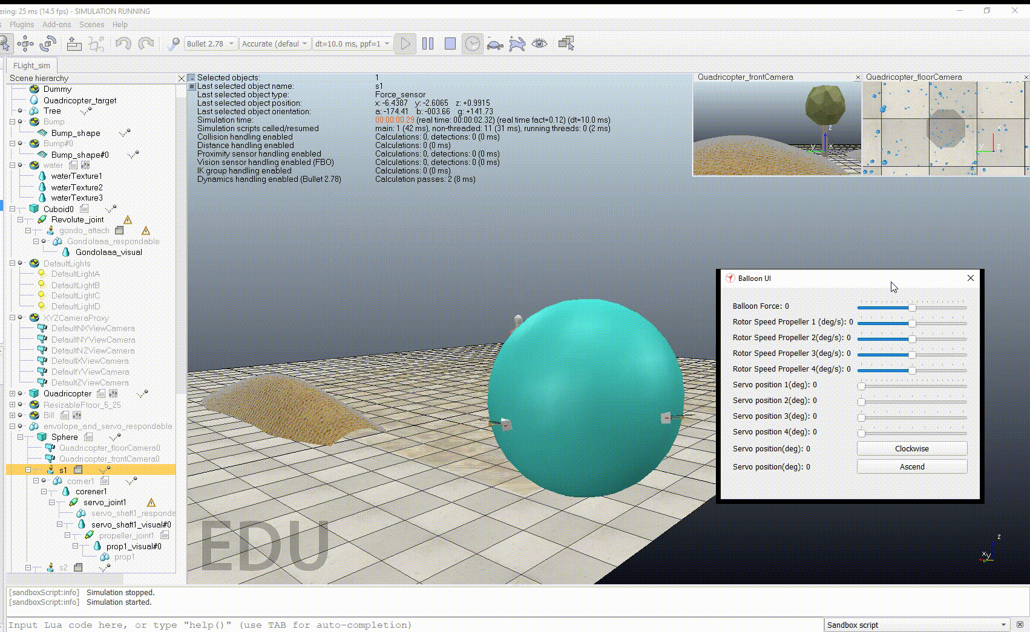
Simulate Buoyancy Force on the Balloon
Goal: Implement Buoyancy Force Using GUI
Buoyancy force is simulated above as part of the lift force of our ballon, the second lift force being the propellers.
Conclusion: GUI applies a singular force not continuous, so a better implementation for the buoyancy forces need to be simulated.

Slide 24
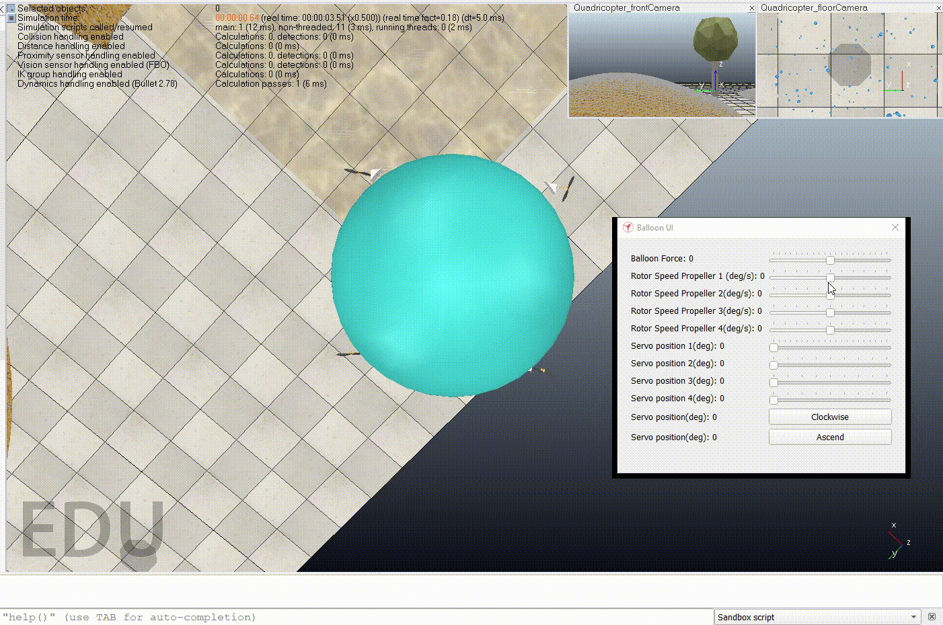
Simulate Propeller Force on the Balloon
Goal: Implement Propeller Forces Using GUI
Drag has not been implemented yet and neither have the propeller forces, so this is what a completed simulation would show for thrust.
Conclusion: Throttle achieved. Implementation for Propeller Forces have not yet been completed, but a completed simulation would allow thrust and rotation.

Slide 25
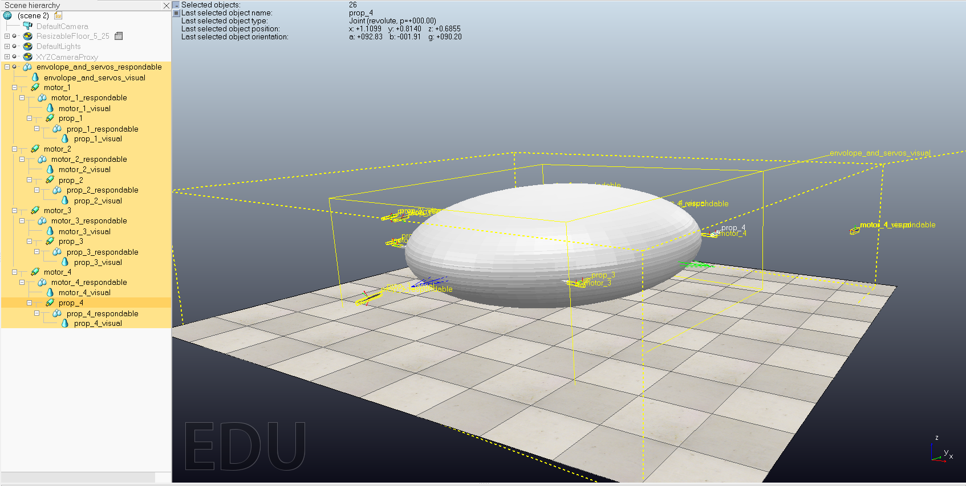
Simulation Next Steps
Incorporate the next CAD design into the simulation
Implement propeller forces and torques
Implement drag forces on the balloon
The newest imported design of our CAD model. Parts are still needed to be attached to the balloon and each other.

Slide 26
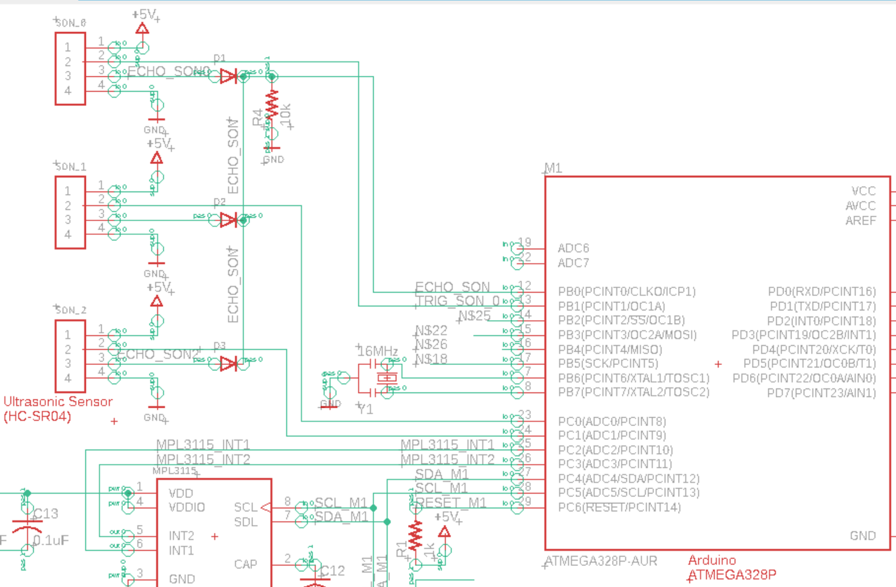
Hardware implementation for Autonomous Terrain Tracking
4.2.1
Front
V1.5
Only one Input Capture Pin in ATMega328P, resulting in 3 ultrasonic sensors sharing 1 IC pin
(1)
Goal: Understanding how the MC receive distance from ground, ahead, and behind.
Back
ATMega328p Microcontroller
(1)
Conclusion: MC reads distance via 3 digital output pins for each ultrasonic sensor. However, all 3 sensors use the same trigger pin from MC.
Input Capture
Bottom
Digital Output
(1)
>10us logic high to read Front, Back, and Bottom distance of the drone
(1)Prevents Echo output pins from receiving inputs
Notes:
Goal: Sensor Setup for Terrain Tracking
Conclusion: How feasible is it. Requirement for setup

Slide 27
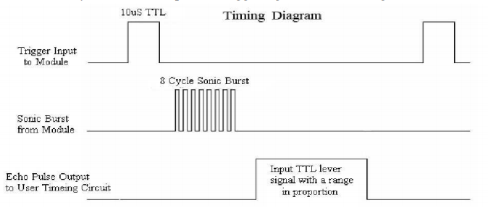
Programming the Sensors: Ultrasonic
4.2.1
Goal: Read from ultrasonic to determine distance
Procedure:
Begin loop: Set trigger pin low for 2 microseconds
Set trigger pin high for 10 microseconds
Wait for ultrasonic to transmit and receive signal back, track the time taken
Determine distance knowing speed of sound and time of travel
Conclusion: Because the code is currently run in the main loop, waiting for the signal to come back from the ultrasonic sensor stalls the program and stops anything else from running. Using interrupts would work much better, since the main program could still run while waiting and act when the interrupt gets triggered from the signal coming back
*Demonstration shown on next slide

Slide 28
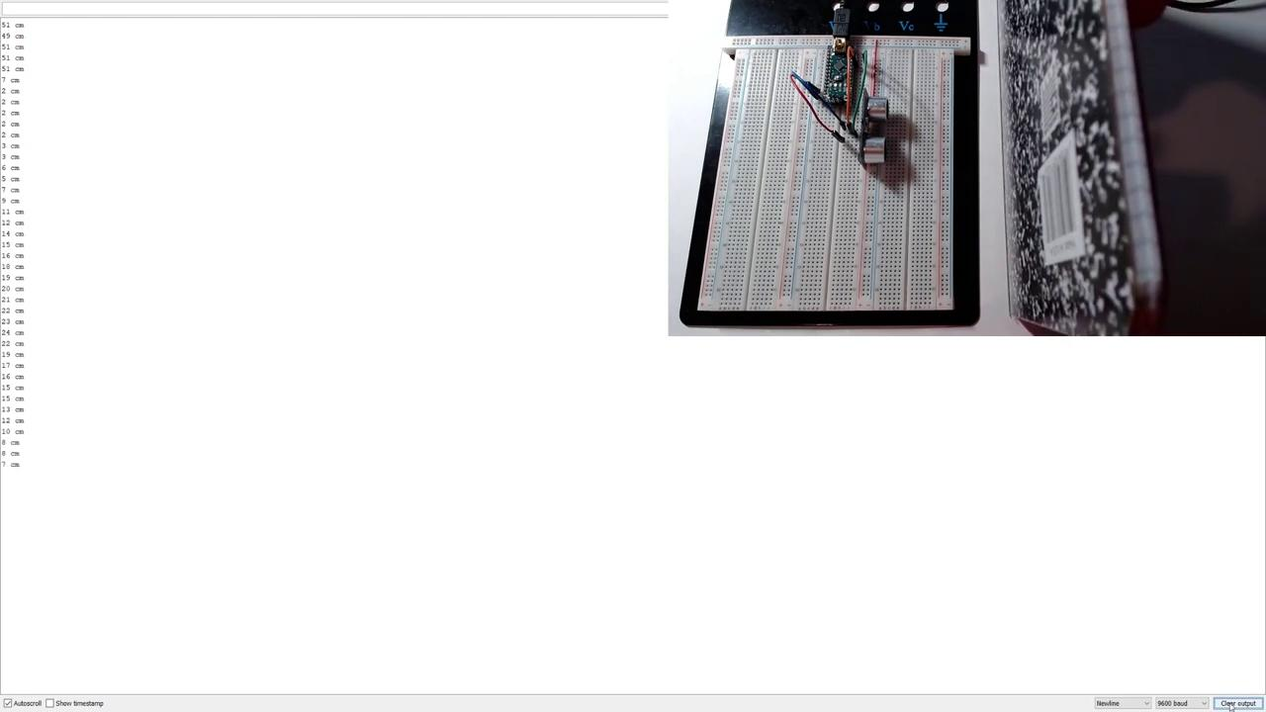
Programming the Sensors: Ultrasonic
4.2.1

Slide 29
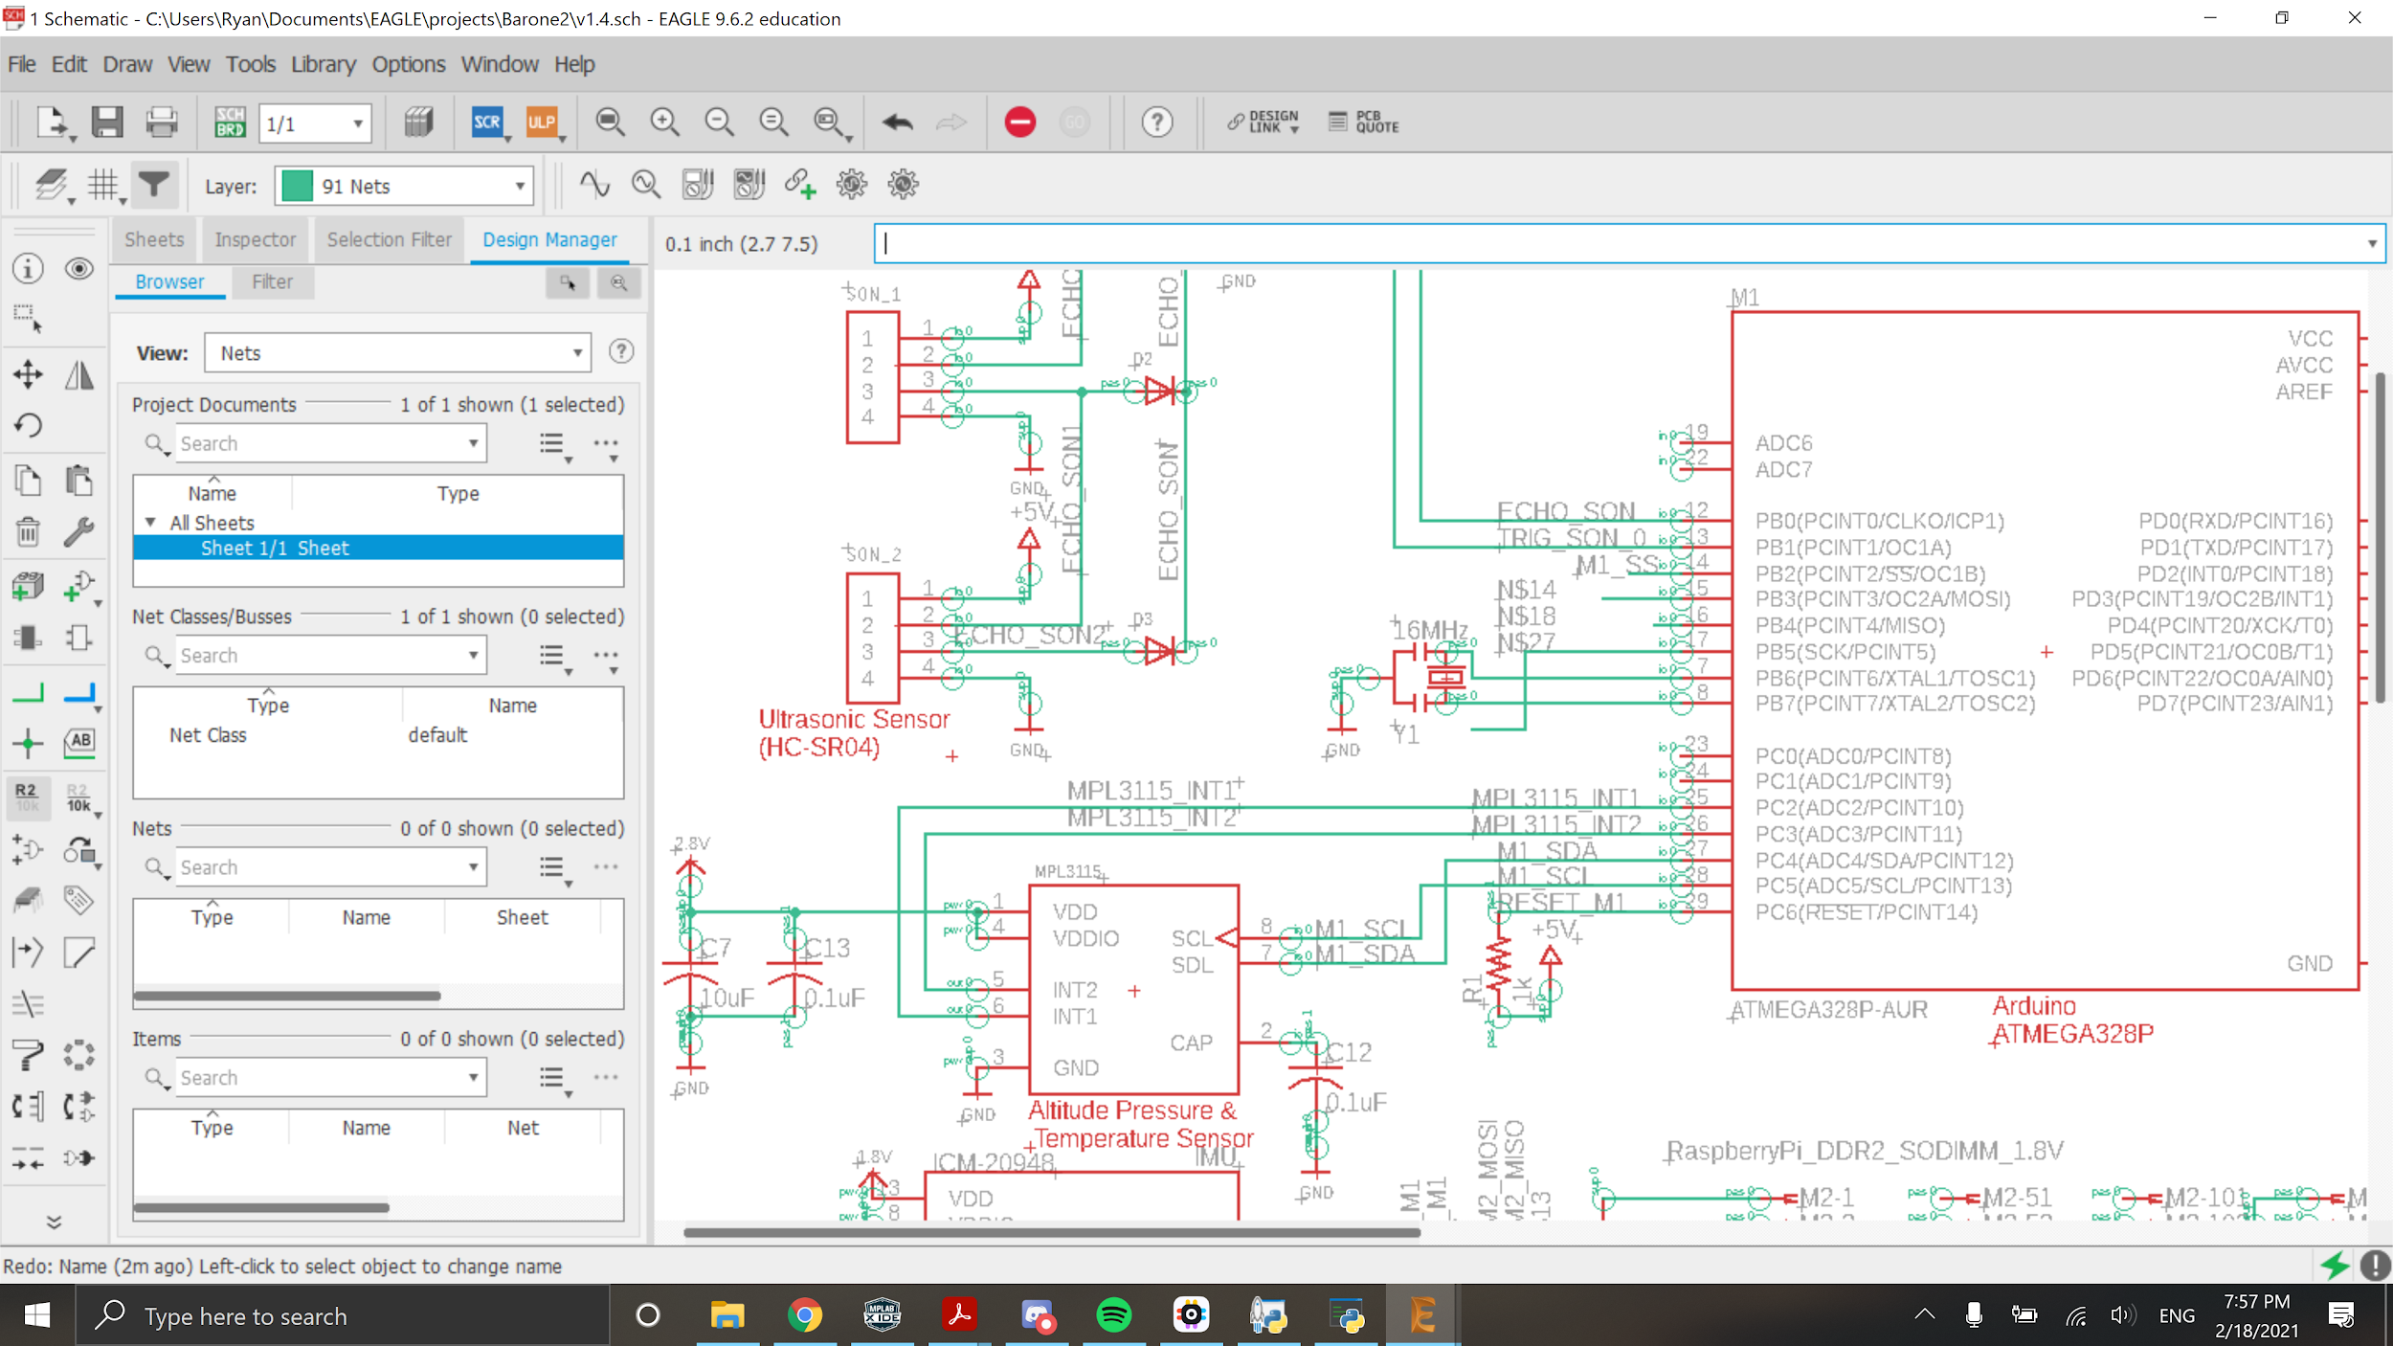
Hardware implementation of Autonomous high altitude tracking Barometric sensor
4.2.2
V1.4
Goal: Understand how the MC receives Pressure and Temperature data from Barometric sensor
Programmable Interrupt pin INT1 & INT2 output from Slave. Can be triggered when new Pressure & Temperature is detected
Pressure Sensor & Microcontroller Serial Data
ATMega328p Microcontroller
Barometric Sensor Interrupt INT1 & INT2 connected to programmed digital Input pins 10 & 11
Conclusion: MC can be notified when new data is available via 2 interrupt pins. Pressure and temperature data is transmitted via I2C pins
Digital Input PC 2
Digital Input PC 3
SDA
SCL
Pressure Sensor & Microcontroller Serial Clock
External pull down capacitor

Slide 30
Programming the Sensors: Altimeter
4.1.1
Goal: Read from altimeter to determine altitude
Procedure:
Set I2C protocol, initialize I2C clock speed, and start I2C
Wait until altimeter is detected properly
Begin loop: if new data is ready, read it
Convert raw data to pressure, altitude, and temperature values
Conclusion: The altimeter gave correct values for pressure and temperature, but I was getting a negative number for altitude. To fix this, I will need to go into the libraries I used and see exactly how they polled the altimeter for altitude.
*Demonstration shown on next slide

Slide 31

Programming the Sensors: Altimeter
4.1.1

Slide 32
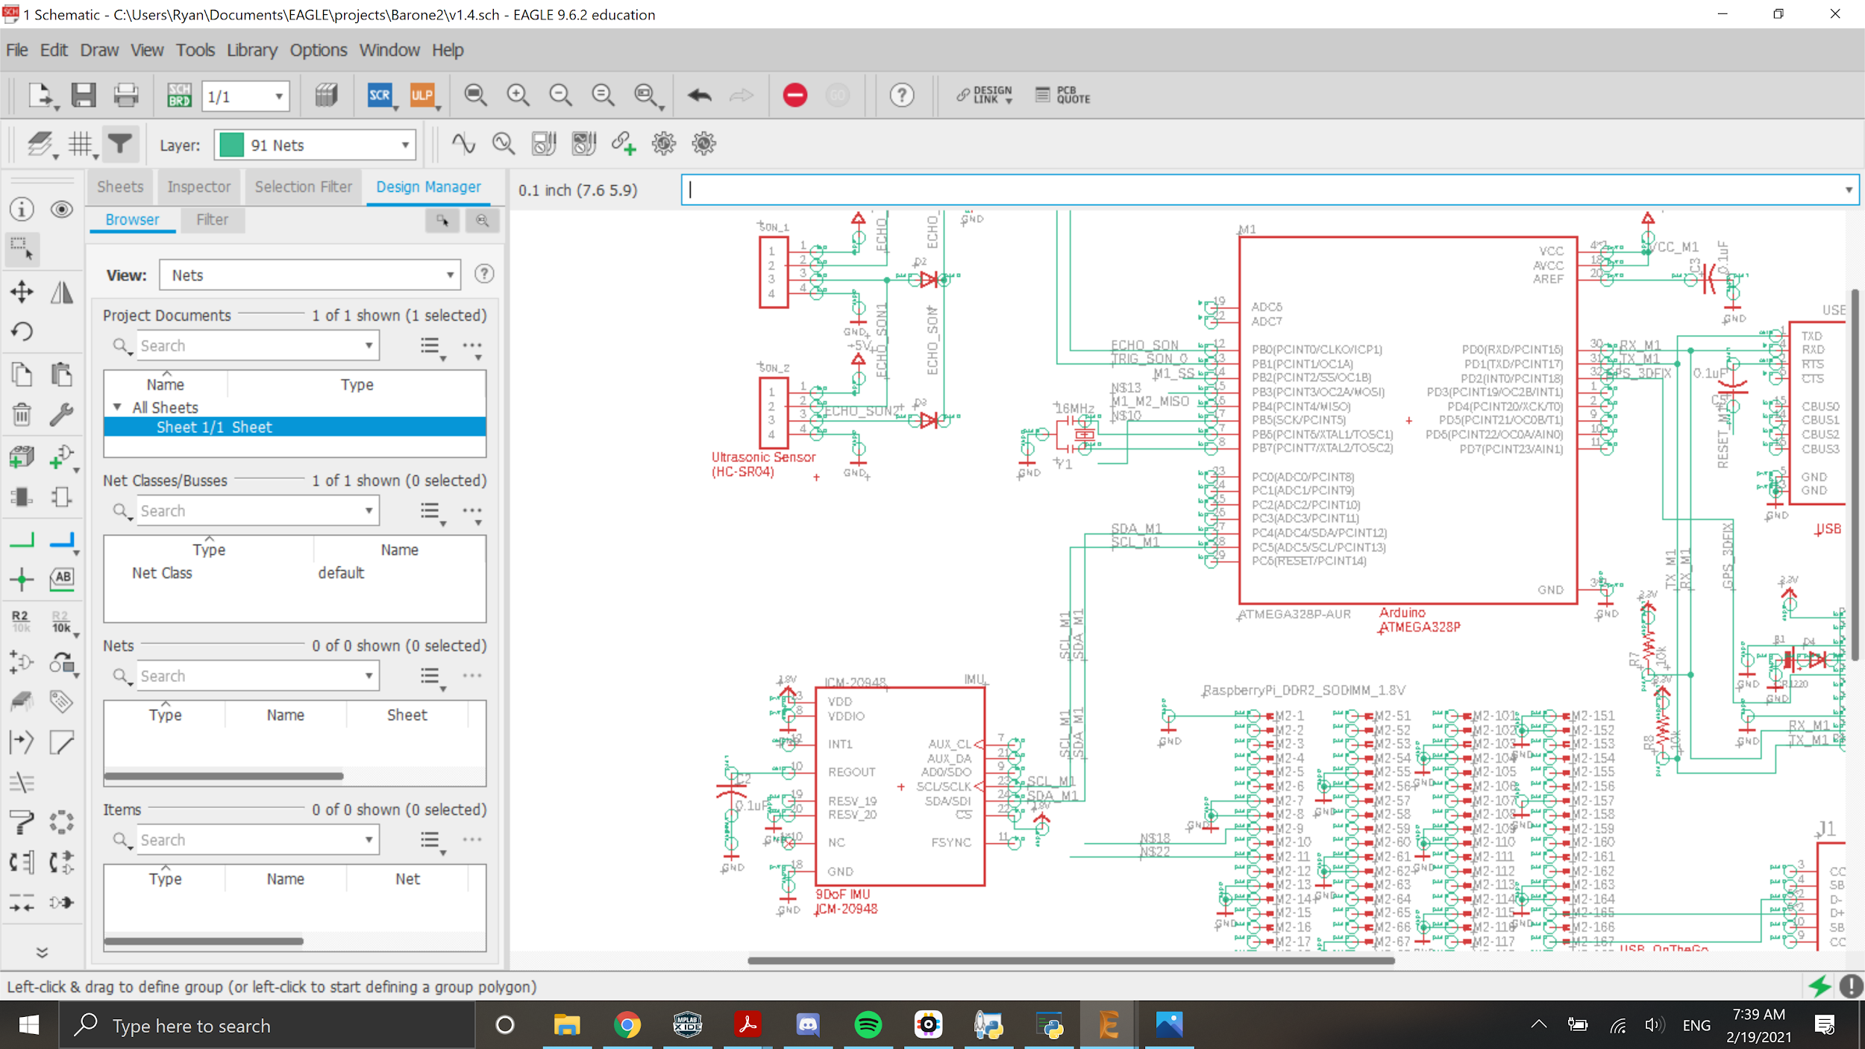
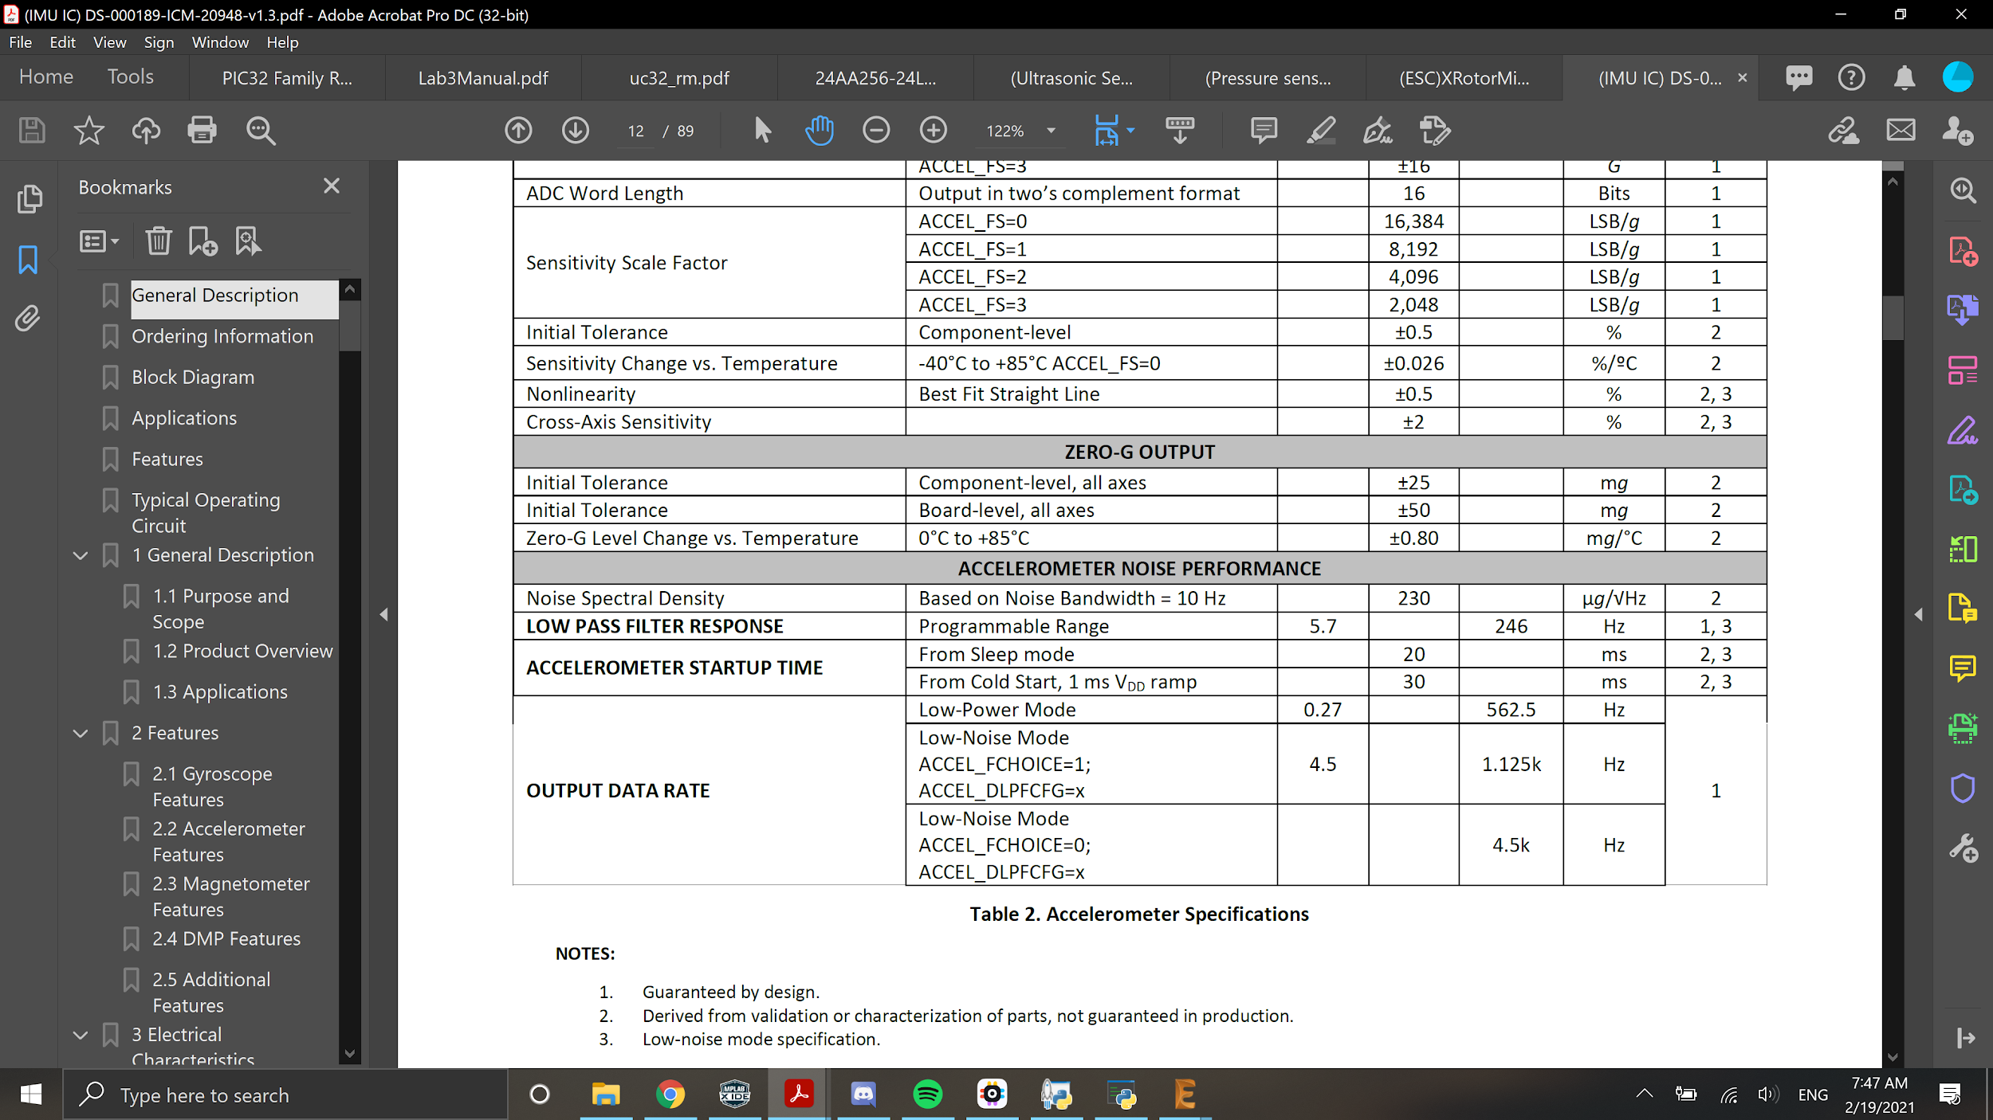
Hardware implementation of fall detection IMU
4.3.1
V1.4
ATMega328p Microcontroller
3-axis gyroscope, accelerometer, and magnetometer data transmitted via I2C
890us max response time for fall detection and autonomous flight correction.
SDA
SCL
Goal: Understand how MC receives Gyroscope,accelerometer, and magnetometer data from IMU.
400kHz max sampling rate via I2C
Conclusion: Gyroscope,accelerometer, and magnetometer data are sent via I2C, same as Barometric sensor. Max polling rate each data type can be configured between 1.125kHz to 4.5kHz to conserve power usage.

Slide 33
Programming the Sensors: IMU
4.3.1
Goal: Read from IMU to determine orientation
Procedure:
Set I2C protocol, initialize I2C clock speed, and start I2C
Wait until IMU is detected properly
Begin loop: if new data is ready, read it
Convert raw data to accelerometer, gyroscope, and magnetometer values
Conclusion: The IMU gave sensible numbers, and reacted accordingly when I moved it around, but it gave false readings when I wasn’t touching it, and drifted over time. To fix this, I will need to calibrate the IMU by biasing it with an average reading when not touching it at all.
*Demonstration shown on next slide

Slide 34
Programming the Sensors: IMU
4.3.1

Slide 35
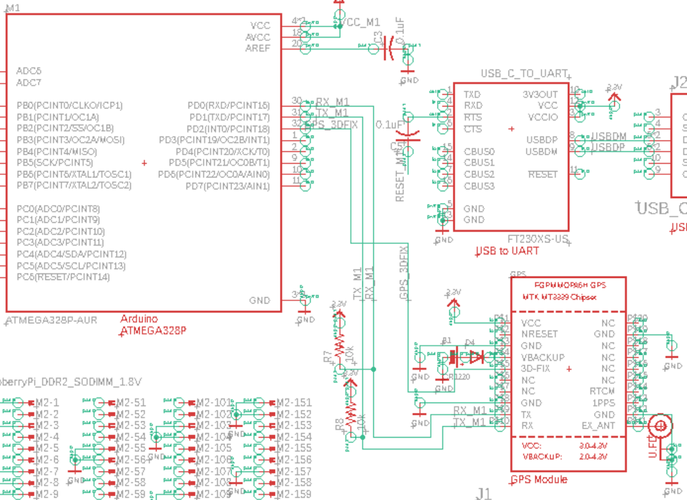
Hardware Implementation of Autonomous GPS path following
4.1.1
V1.5
ATMega328p Microcontroller
Goal: Understand how MC knows when GPS module has satellite lock and how coordinates are received by MC.
UART Communication Protocol
RX
TX
Digital Input PD2
Location updates every 100ms tops
Conclusion: Satellite lock received when a logic low input to MC’s PD2 pin. GPS coordinates transmitted via UART pins to the MC.
3DFIX pin logic low when at least 1 satellite lock

Slide 36
Programming the Sensors: GPS
4.1.1
Goal: Read from GPS to determine latitude/longitude
Procedure:
Set UART protocol, initialize clock speed, and start UART
Wait until GPS is detected properly
Begin loop: if new data is ready, read it
Convert raw data to time, date, latitude and longitude, speed, angle, altitude, and number of satellites
Conclusion: The GPS gave very accurate readings, but I ran into an issue where I was not able to use the Arduino’s dedicated UART hardware at the same time as I had it connected to my computer for debugging since they used the same lines. To fix this, I had to switch over to implementing UART through software rather than hardware, which is slower and stops everything when reading and sending a character.
*Demonstration shown on next slide

Slide 37
Programming the Sensors: GPS
4.1.1

Slide 38
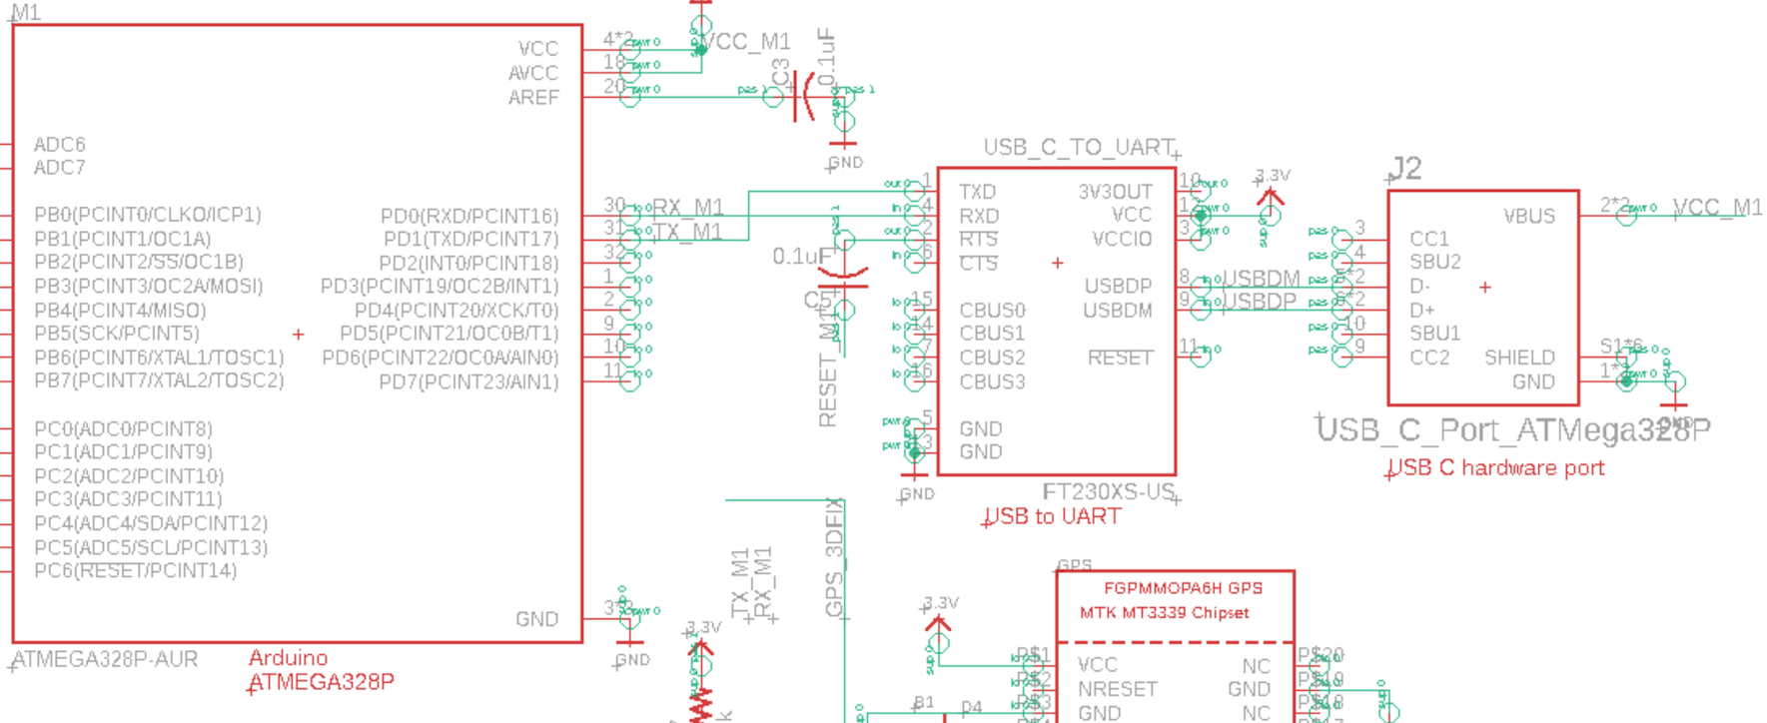
Hardware implementation of Programmable GPS Pre-planned Path
4.7.0
Hardware USB-C Port
V1.5
ATMega328p Microcontroller
RX
TX
Fully programmable microcontroller via USB-C port. Used for uploading GPS pre planned path
USB to UART IC
Goal: Understand how MC is programmed via USB Type C port.
Conclusion: The MC is programmed by UART pins from the USB to UART IC, which is connected to a physical USB Type C port. The USB to UART IC converts USB Protocol to UART Protocol.

Slide 39
Programming the Arduino to the Raspberry Pi
3.1.2
Goal: Connect the Arduino and Raspberry Pi so that they can send information to each other
Procedure:
Connect the Arduino and Raspberry Pi via SPI, since I2C is used for Arduino and sensors, UART is already being used by GPS sensor/USB to Arduino, and no other USB ports. Use voltage divider/regulator between Arduino and Raspberry Pi because Arduino outputs 5V while Raspberry Pi pins only take in 3.3V
Set SPI procedure on both Raspberry Pi and Arduino side, wait until both connect to each other
Send data from Raspberry Pi to Arduino, manipulate the data, and have Arduino send back to Raspberry Pi
Conclusion: The two devices successfully communicated with each other. Ideally, USB would be easier as it would require less wires and no need for regulating the voltage, so another Raspberry Pi and Arduino with more USB ports might be considered

Slide 40
Power Requirements for Microcontroller and Microprocessor
Goal: Find Power Required for Microcontroller and Microprocessor
1.1.0
Power Budget V2.1
Name | Description | Nominal Voltage(V) | Total Consumption/Cycle(mA*hrs) |  | Total Energy/Cycle (mW*hrs) |  | Power% | Comments
ATMega 328p | Microcontroller | 5 | 11.7 |  | 58.5 |  | 0.08% | Always on during 1hr flight, small(1mA) leakage current estimated¹
Raspberry Pi Compute Modules | Microprocessor | 5 | 401 |  | 2005 |  | 2.81% | Power used variant on activity, recommended minimum estimated(overestimated)²
^ | 3v3 | 3.3 | 251 |  | 828.3 |  | 1.16% | ²
^ | 1v8 | 1.8 | 251 |  | 451.8 |  | 0.63% | ²
^ | VDAC | 2.8 | 26 |  | 72.8 |  | 0.10%
^ | GPIO 0-27 | 3.3 | 51 |  | 168.3 |  | 0.24% | only 5 pins used, max 50mA current per I/O set, also slightly overestimated³
^ | GPIO 28-45 | 3.3 | 51 |  | 168.3 |  | 0.24% | ³
TOTAL |  |  | 1042.7 |  | 3753 |  | 5.27%
Conclusions
Microprocessor may be overestimated, need PCB simulation for further estimates
Notes:
What is conclusion?

Slide 41
Power Requirements for Sensors
Goal: Find Power Required for Sensors
1.1.0
Power Budget V2.1
Name | Description | Nominal Voltage(V) | Total Consumption/Cycle(mA*hrs) |  | Total Energy/Cycle(mW*hrs) |  | Power% | Comments
MPL3115A2 | Pressure/Temperature Sensor VDD | 2.5 | 2.265 |  | 5.6625 |  | 0.01% | Always on during 1hr flight, small(1mA) leakage current estimated¹
^ | VDDIO | 1.8 | 1 |  | 1.8 |  | 0.00% | ¹, I/O pin current not specified
HC-SR04 | Ultrasonic (3 count) | 5 | 48 |  | 240 |  | 0.34% | ¹
MTK 3339 | GPS Module | 3.3 | 26 |  | 85.8 |  | 0.12% | ¹
^ | GPS Antenna | 3.3 | 21 |  | 69.3 |  | 0.10% | ¹
ICM-20948 | IMU 9DoF IC | 1.8 | 4.34 |  | 7.812 |  | 0.01% | ¹
Raspberry Pi Camera Module V2 | Camera (3 count) | 5 | 753 |  | 3765 |  | 5.28% | ¹, cameras not finalized, alternate camera will use much less power
TOTAL |  |  | 855.6 |  | 4175 |  | 5.85%
Conclusions
Switching to a single new camera module, will likely use much less power than the previous ones
PCB simulation can also tell us how efficient estimates are

Slide 42
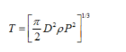
Power Requirements for Motors and Servos
Goal: Find Power Required for Motors and Servos
1.1.0
Power Budget V2.1
Name | Description | Nominal Voltage(V) | Total Consumption/Cycle(mA*hrs) |  | Total Energy/Cycle (mW*hrs) |  | Power% | Comments(V2)
D1306-CCW | Motor(4 count) | 7.4 | 8256 |  | Assuming rising 1/4 of the time P = k * m^(3/2) / r k = constant = 22.35 r = radius = .1143m m = mass = .25kg P = power = 3.303A per motor full throttle, Half that to hover 61094.4 |  | 85.72% | May not need telemetry Alternate Power Equation: D=diameter=.2286m T = thrust = 2.45N rho = 1.225kg/m^3 P = Power 1.63A at full throttle, half for hover Need to find efficiency of motor with prop
AFHDS 2A system | Turnigy iA8 Receiver | 5 | 2 |  | 10 |  | 0.01% | Current for receiver not specified Controller uses 8 AA batteries
CS238MG Metal Gear Servo | Servo (4 count) | 5 | 403 |  | 2015 |  | 2.83% | Depends on how much time drone is turning, assuming 1/4 of the time
TOTAL |  |  | 8661 |  | 63119 |  | 88.56%
Equation from: https://justdrones.com.au/how-much-power-is-needed-to-hover/
Equation from: quadcopterproject.wordpress.com/static-thrust-calculation/
Conclusions
Power use of motor highly variable, need better estimate based on motor efficiency and rpm with prop
General power use highly based on user input(turning and rising require more power), motors themselves still being decided, along with whether telemetry will be needed or not

Slide 43
Power Requirements for Miscellaneous Items
Goal: Find Power Required for Regulators and Accessories
Conclusions:
Current leakage on regulators may be underestimated
Need general power use of resistors and capacitors in PCB schematic(Pull up/down, low/high pass filters)
1.1.0
Power Budget V2.1
Name | Description | Nominal Voltage(V) | Total Consumption/Cycle(mA*hrs) |  | Total Energy/cycle (mW*hrs) |  | Power% | Comments(V2)
MIC5225-1.8YM5-TR | 7V to 1.8V Voltage Regulator | 7 | 8.1 |  | 56.7 |  | 0.08% | Always on 1hr flight, 1 hr peripheral also draw estimated¹
MIC5225-2.8YM5 TR | 7V to 2.8V Voltage Regulator | 7 | 5.1 |  | 35.7 |  | 0.05% | ¹
MIC5225-3.3YM5-TR | 7V to 3.3V Voltage Regulator | 7 | 3.1 |  | 21.7 |  | 0.03% | ¹
MIC5225-5.0YM5 TR | 7V to 5.0V Voltage Regulator | 7 | 3.1 |  | 21.7 |  | 0.03% | ¹
FT230-XS-U | USB to Serial Uart IC | 5 | 18 |  | 90 |  | 0.13% | ¹
TOTAL |  |  | 37.4 |  | 225.8 |  | 0.32%

Slide 44
Power Rails Required
Goal: Identify different power rails required for the system
Conclusions:
Rail 1 from the battery will have to power each other rails through a voltage regulator
Will leave most of the current to power motors
Max Regulated Current is based off ground current loss depending on rail current load
Will have to use diodes instead of regulator on Rail 2 due to high current
1.1.1
Power Budget V2.1
Rails | Items | Max Voltage(V) | Max Current(mA) | Max Regulated Current(mA) |  | Heat Dissipation(mW)
Rail 1 | 5 | 7.4 | 3322 | N/A |  | 24582.8
Rail 2 | 10 | 5 | 1852 | 1790 |  | 8951.3
Rail 3 | 5 | 3.3 | 395 | 382 |  | 1206
Rail 4 | 2 | 2.8 | 27 | 26 |  | 72.8
Rail 5 | 3 | 1.8 | 253 | 244 |  | 440.2

Slide 45
Provisional Battery Selection
Goal: Find the most efficient battery selection
Conclusions:
Battery shown should exceed 1 hour flight goal based on current estimations
PCB testing should confirm all component power draw, except motors
Final battery selection still in progress
Will also need charger for testing
1.1.2
1.0.0
Power Budget V2.1
 | Max Voltage | Total mAh/Cycle |  | Total mWh/Cycle
System | 7.4V | 10596 |  | 71273
LIPO 11000 2S 7.4V | 7.4V | -11000 |  | -81400

Slide 46
Questions?

